Slide 1

Final Capstone Project
Presented by: Wejdan Othman Albalawi

Slide 2
Orientation
Final Capstone Project

Slide 3
Agenda
Bootcamp Overview
Project Overview
Approach to Solution
Technology Used and Why?
Key Learnings & Outcomes
Live Demo

Slide 4
Bootcamp Overview
Systematic Development Process:
Analyzed requirements and selected appropriate design patterns to initiate problem-solving.
Effectively distributed tasks and managed version control using Git.
Chose and designed the most suitable database.
Developed the backend using Java with libraries and techniques for well-organized code.
Worked on the frontend using Angular and designed HTML pages, creating a complete development workflow from start to finish.
Unique Tool Experience:
Learned to use CAgen, a helpful and intuitive tool for building code and interfaces, which provided a unique and exceptional experience.

Slide 5
Project Overview
Introduction:
Advances in telecommunications have led to the rise of fields like telehealth and telemedicine. However, rising healthcare costs and the remoteness of some areas make accessing health services challenging.
Project Idea:
A web application platform that allows patients to receive remote consultations securely and privately from verified doctors while maintaining data confidentiality and patient consent.
Project Goals:
Provide remote consultations.
Ensure security and privacy.
Maintain data confidentiality and patient consent.

Slide 6
Project Overview
Customer Journeys
Doctor Journey :
Doctor should be able to register and login
Doctor should be able to define and manage availability schedule
Doctor should be able to check all pending consultation requests
Doctor should be able to give consultation to a pending request
Doctor should be able to record a patient’s diagnosis
Doctor should be able to search patients’ medical records
Patient Journey :
Patient should be able to register and login
Patient should be able to search for doctor by dynamic criteria [specialties, ratings, availability, id, or name]
Patient should be able to request consultation from a selected doctor
Patient can check a consultation result
Patient can request a medical history report for all previously recorded diagnosis
Patient should be able to rate a doctor

Slide 7
Project Overview
Customer Journeys
Doctor Journey :
The doctor can search medical reports (medical Report) by patient name, email, patient ID, and report details Doctor should be able to define and manage availability schedule/ medical Report/ consultation
The doctor can add and edit medical reports (medical Report).
The doctor can view their own evaluation.
The doctor can search for the patient information..
Patient Journey :
The patient can search for medical records using the ID.
The patient can search for doctors based on their previous evaluations.
The patient can search for a specific doctor to view their evaluation.
The patient can search whether a specific doctor is available or not.
The patient can search for all available doctors.

Slide 8
Approach to Solution
Backend Development :
Architecture: Implement the MVC (Model-View-Controller) design pattern to ensure a well-organized and scalable codebase, facilitating easier maintenance and future enhancements.
Database: Define SQLite tables for DOCTORS, PATIENTS, CONSULTATIONS, SCHEDULES, and MEDICAL_REPORTS, and Ratings to efficiently manage and store critical data, ensuring optimal performance and data integrity.
Setup: Utilize IntelliJ IDEA for Java development and seamlessly integrate SQLite as the database to maintain robust data persistence and simplify development workflows.
Implementation: Create secure and efficient RESTful APIs to handle all CRUD (Create, Read, Update, Delete) operations, employing industry best practices for security and ensuring compliance with data privacy regulations.
Frontend Development :
Architecture: Build modular UI components using Angular's component-based architecture to foster reusability and maintainability, enhancing user interface flexibility and responsiveness.
Database: Utilize Angular CLI for rapid project setup and scaffolding, enabling quick prototyping and development of frontend features.
Integratio: Integrate frontend components seamlessly with backend APIs, leveraging asynchronous communication techniques to deliver real-time data updates and ensure a smooth user experience.
Implementation: Deploy the Angular frontend on scalable cloud platforms such as AWS or Azure, implementing continuous deployment practices to streamline updates and ensure high availability and reliability.

Slide 9
Approach to Solution
Project Organization:
Management:
Efficient time management was implemented to work on both backend and frontend development.
Communication:
Scheduled regular meetings with the camp's instructor to address some issues such as technical challenges and project updates periodically.

Slide 10
Technology Used and Why?
Backend Development:
Java (J2SE)
SQLite: Lightweight and efficient, it's a popular choice for embedded and local storage solutions due to its simplicity and portability..
Components:
Core Java: Fundamental for backend logic implementation.
Java Servlets: handling of HTTP requests.
MVC Architecture: Organizes software into Model, View, and Controller components, enhancing modularity and maintainability.
IntelliJ IDEA: Preferred Integrated Development Environment (IDE) for Java development.
Frontend Development:
Angular: Component-based framework for building dynamic web applications.
HTML and CSS: HTML structures web content, while CSS styles enhance its presentation with fonts, colors, and layout.

Slide 11
Key Learnings & Outcomes
Benefits and Skills:
- Technical Growth: Gained advanced proficiency in Java (J2SE) for backend development and efficient database management using SQLite.
- Web Development: Enhanced skills in Angular, HTML, and CSS, boosting the ability to create responsive web interfaces.
- Problem-Solving : Improved troubleshooting skills.
- Collaboration: Strengthened teamwork and version control abilities using Git.
-Time Management: Developed effective time management strategies.
-Handling Pressure: Enhanced ability to work efficiently under pressure.
Outcome:
Achieved significant progress in both technical expertise and soft skills, equipping for successful software development and effective collaborative projects.

Slide 12
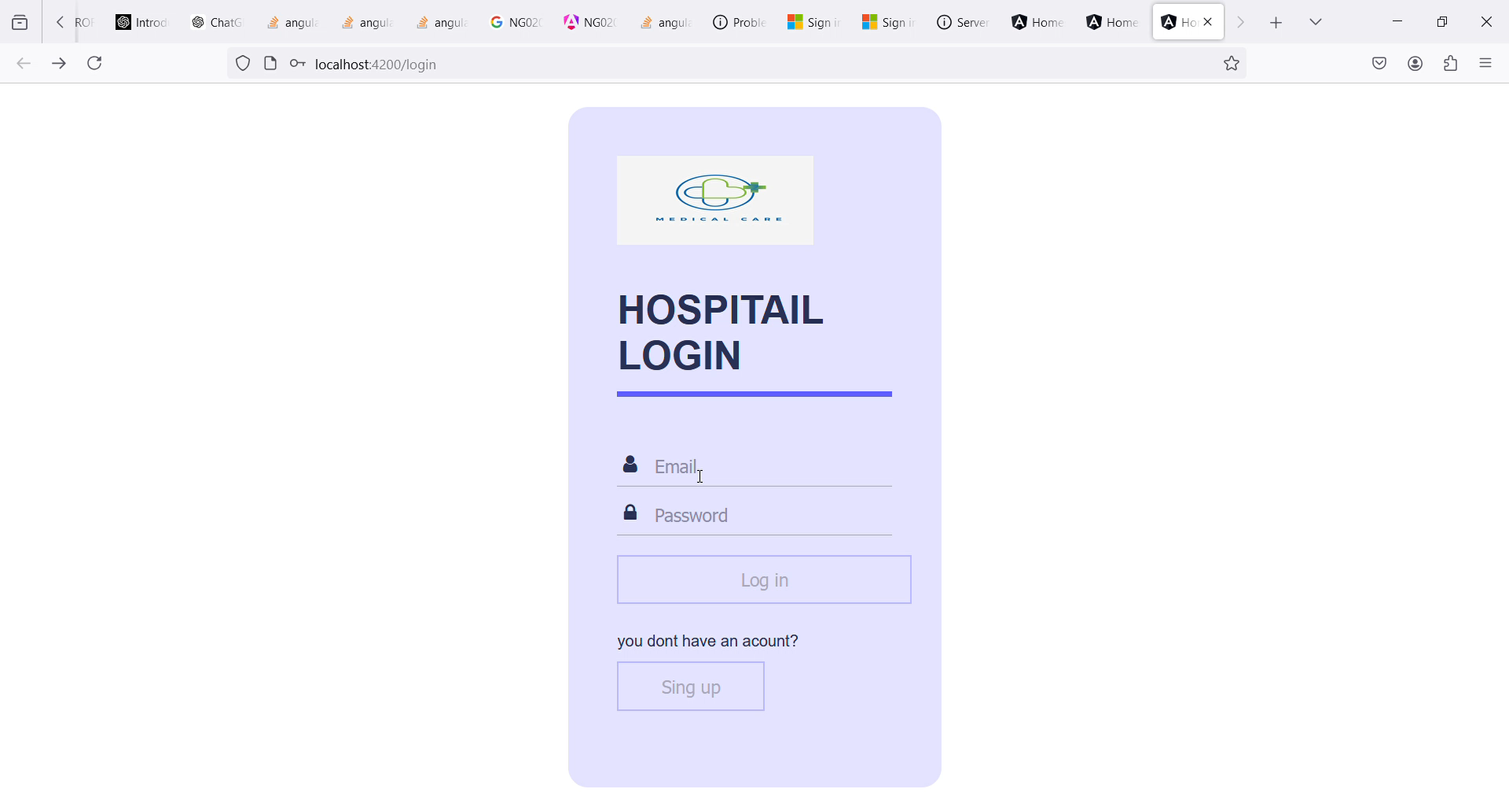
Live Project Demo

Slide 13
Questions
Final Capstone Project

Slide 14


